Slide 1
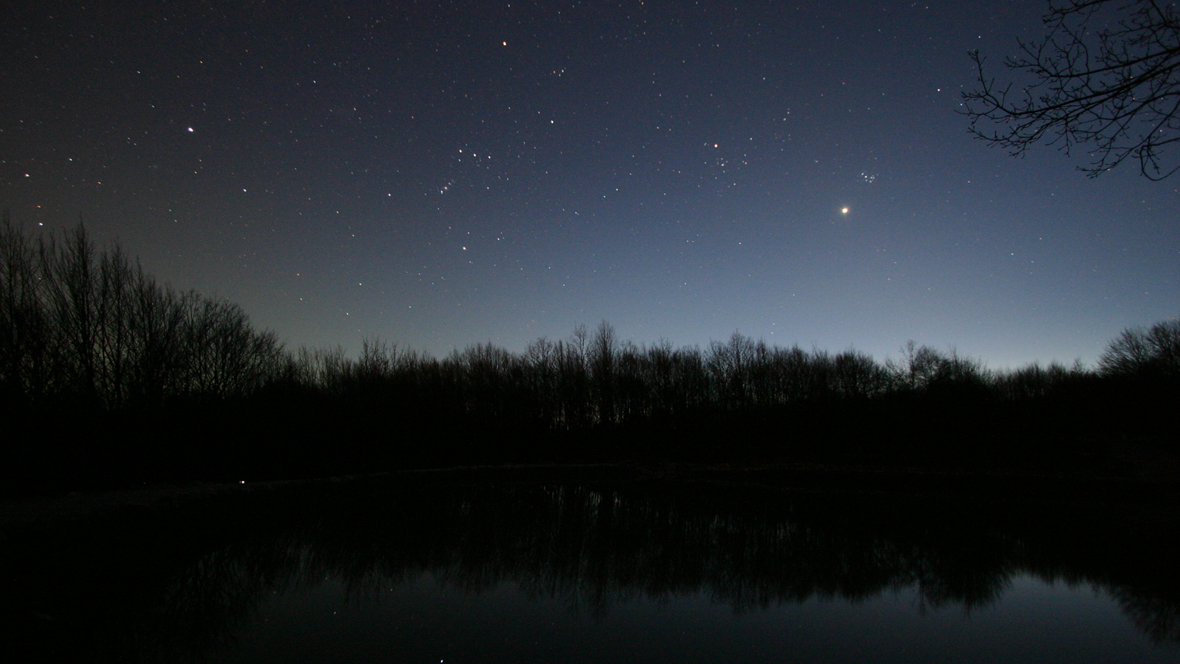

Slide 2
Goals
Realize that you can do science if you’d like
Jump start your lifelong learning about our Universe
Cover what 8th grade science usually covers and then some.

Slide 3
Astronomy Unit
Seasons Today
Moon Phases Wednesday
Solar System Friday
The rest of the Universe Next Tuesday
Exam Next Thursday

Slide 4
Seasons

Slide 5
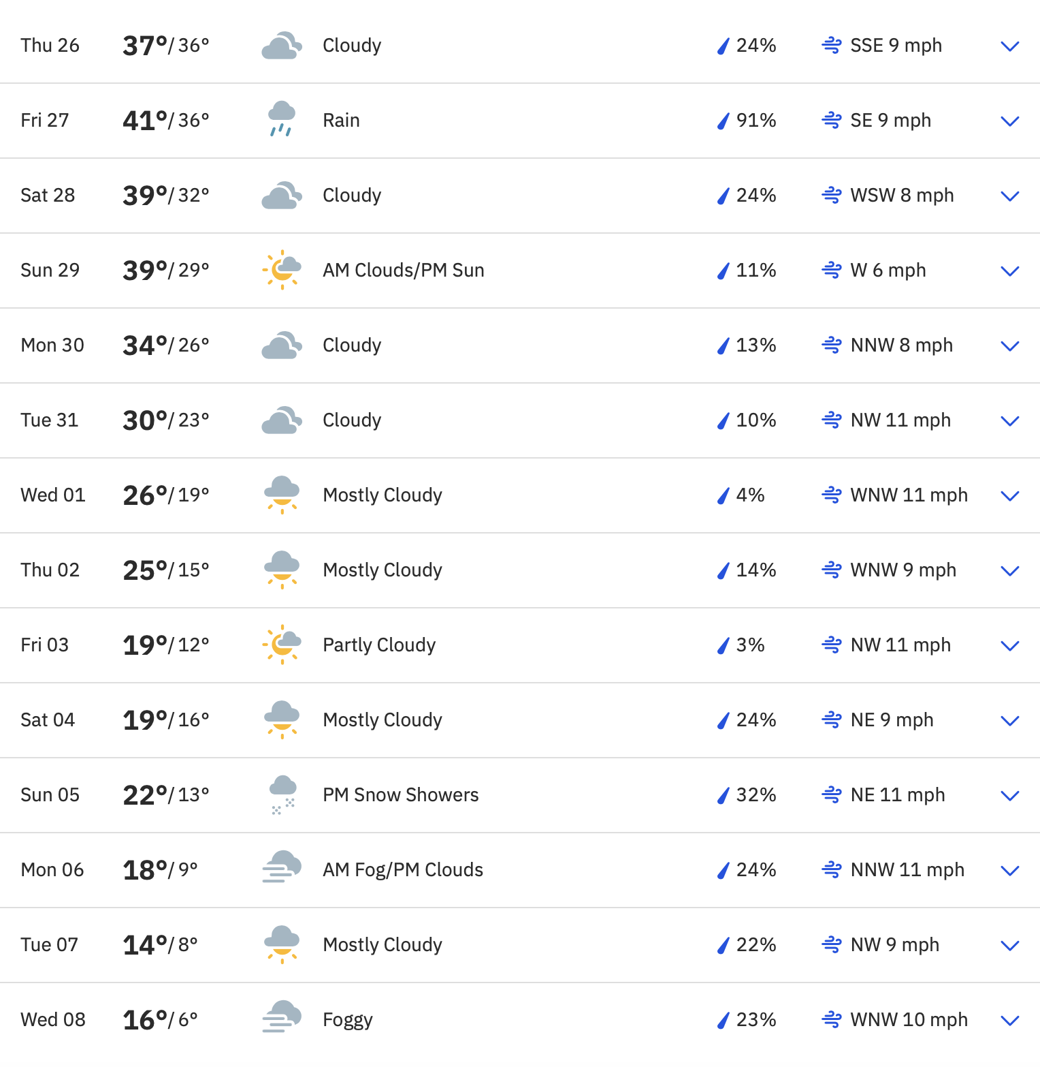
Predicating the weather
Forecasts:
1-10 days
Physics simulations, satellite measurements
2-10 weeks
Chaos!
3 months
Seasonal variations

Slide 6
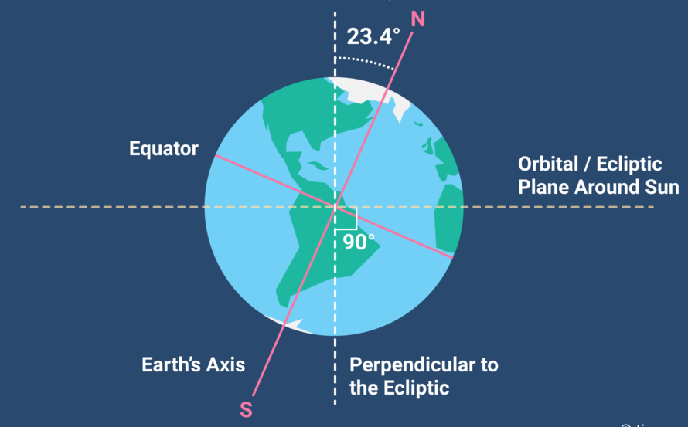
Introduction
Rotation: Spinning around its own axis
Day – night cycle
Revolution: Spinning around something else (you could also say orbit)
Sun’s “motion” around the sky
Axial tilt: Angle between rotation and plane of its orbit
Angle of direct sunlight
Amount of time sun is above the horizon
Notes:
Explain the central question of the lesson: "How does Earth's motion impact our view of the stars, Sun, Moon, and planets?"
Discuss the concept of an observer's perspective and why it's essential in astronomy.

Slide 7
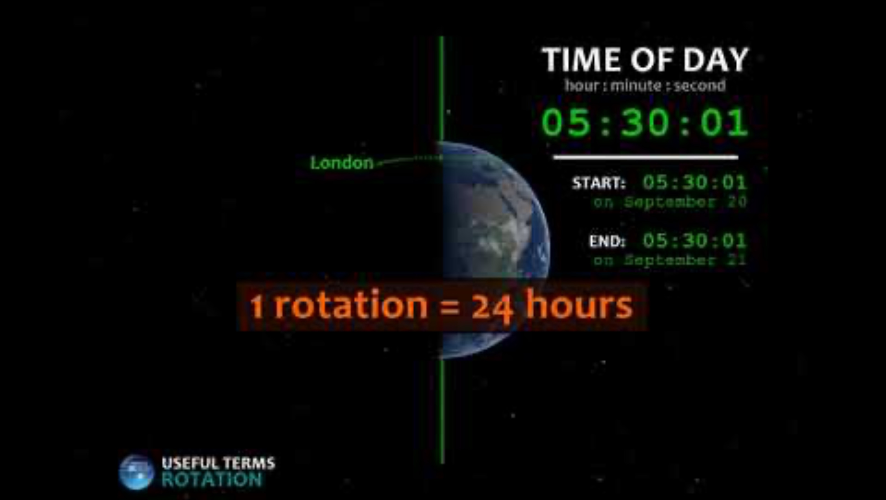

Slide 8
Break

Slide 9
How many times will the Earth rotate in one week?
1 time
7 times
28 times
365 times

Slide 10
How many times will the Earth rotate in one week?
1 time
7 times
28 times
365 times

Slide 11
How many times will the Earth rotate during one full revolution around the Sun?
1 time
7 times
28 times
365 times

Slide 12
How many times will the Earth rotate during one full revolution around the Sun?
1 time
7 times
28 times
365 times

Slide 13
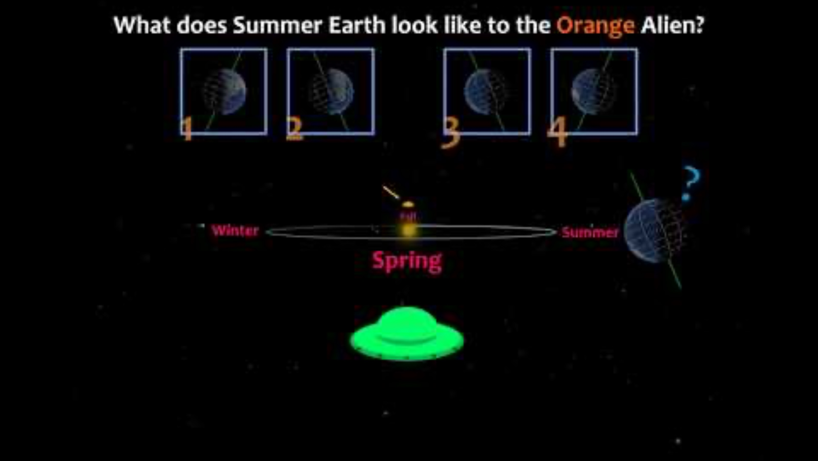
Axial Tilt

Slide 15
Group Activity

Slide 16
Perihelion and Aphelion Distances

Slide 17
World Temperatures
City | Latitude | January Ave. Temp. | July Ave. Temp. | January Ave. Daylight Hours | July Ave. Daylight Hours
Fairbanks, AK | 64.8 N | -2.0 | 72.0 | 3.7 | 21.8
Minneapolis, MN | 45.0 N | 22.0 | 83.0 | 9.0 | 15.7
Las Cruces, NM | 32.5 N | 57.0 | 96.0 | 10.1 | 14.2
Honolulu, HI | 21.3 N | 80.0 | 88.0 | 11.3 | 13.6
Quito, Ecuador | 0 | 77.0 | 77.0 | 12.0 | 12.0
Apia, Samoa | 13.8 S | 80.0 | 78.0 | 11.1 | 12.7
Sydney, Australia | 33.9 S | 78.0 | 61.0 | 14.3 | 10.3
Ushuaia, Argentina | 54.6 S | 57.0 | 39.0 | 17.3 | 7.4

